Slide 1
NSF CC* PA Science DMZ Project

Slide 2
Agenda
Introduction
Wayne Figurelle
What is a Regional Science DMZ
Grant Dull and Ben Miller
Regional Science DMZ - IT Perspective
Jason Simms
Regional Science DMZ – Research/Administrative Impacts
Rick Adkins
Ezra Lencer
Bill Balint

Slide 3
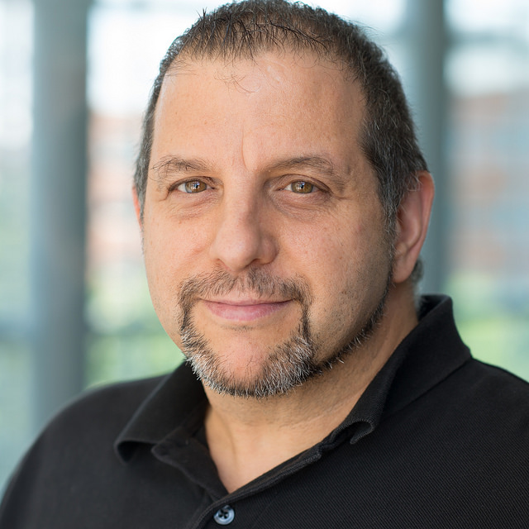
Introduction
Wayne Figurelle, Penn State Institute for Computational and Data Sciences

Slide 4
PA-DMZ Project Overview
Frictionless Network (DMZ)
Goal - establish the foundation for a statewide Pennsylvania Regional Science DMZ (PA-DMZ) that enables and enhances access for under resourced PA institutions of higher education to cyberinfrastructure-based resources and services in support of science driven research and education applications.
Grant supports
Networking hardware and connectivity
Installation and support for 2+ years (organizations to provide support years 3-5)
Broader Impacts and Research Enablement
Grant Link: https://new.nsf.gov/funding/opportunities/campus-cyberinfrastructure-cc

Slide 5
2023 Award Highlights
$1.1M funding
5 partners
PA Research DMZ for Under-resourced Instituions
Install and Operational in 2024
Research Enablement in 2024/2025
Growth and Expansion in 2025

Slide 6
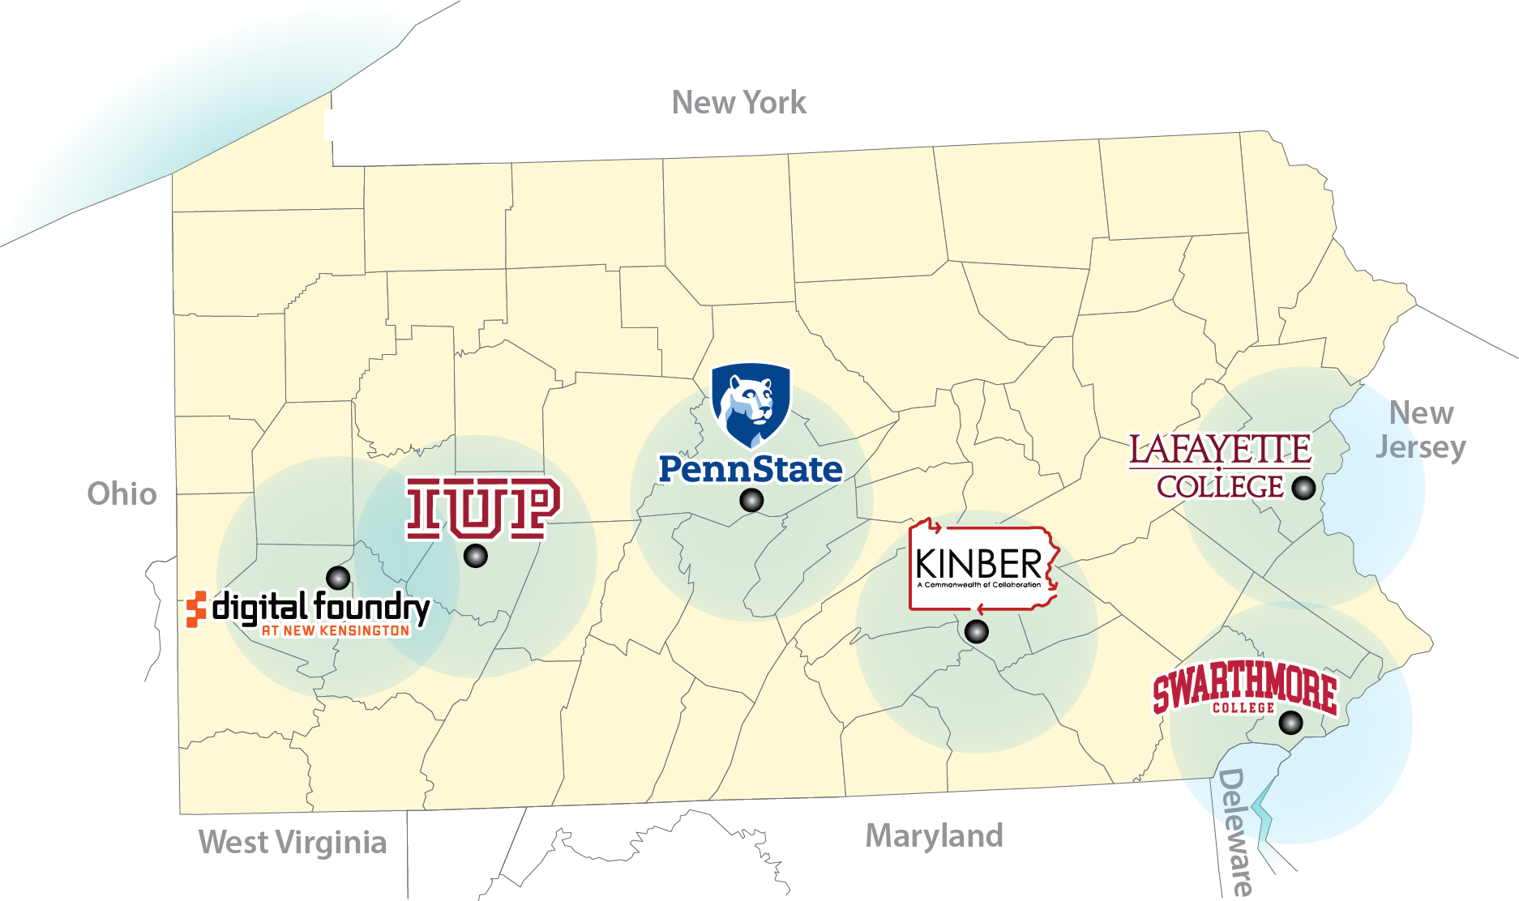
PA-DMZ Current State

Slide 7
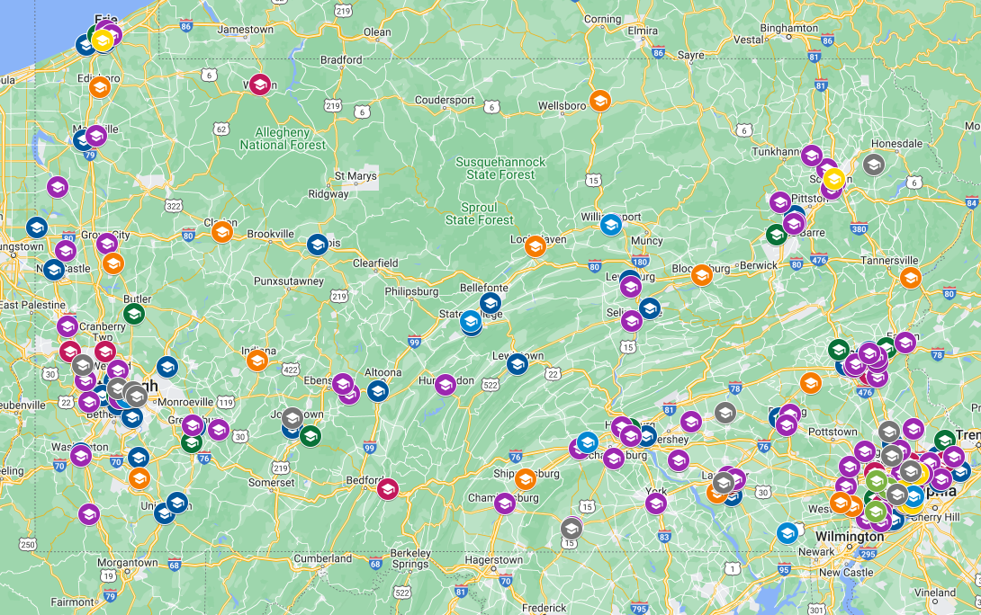
Pennsylvania’s Potential
PA - 24 CC* awards as of Jan 2024
Many under-resourced institutions
Chance to make a change
Map data © 2024 Google – created by a user
Notes:
Connect the power of our institutions and the PA-DMZ is the first of many that we hope to work with partners to extend its efforts – PSU can’t do it on its own

Slide 8
What is a Regional Science DMZ
Grant Dull, Keystone REN
Ben Miller, Keystone REN

Slide 9
Network Diagram

Slide 10
Network Diagram

Slide 11
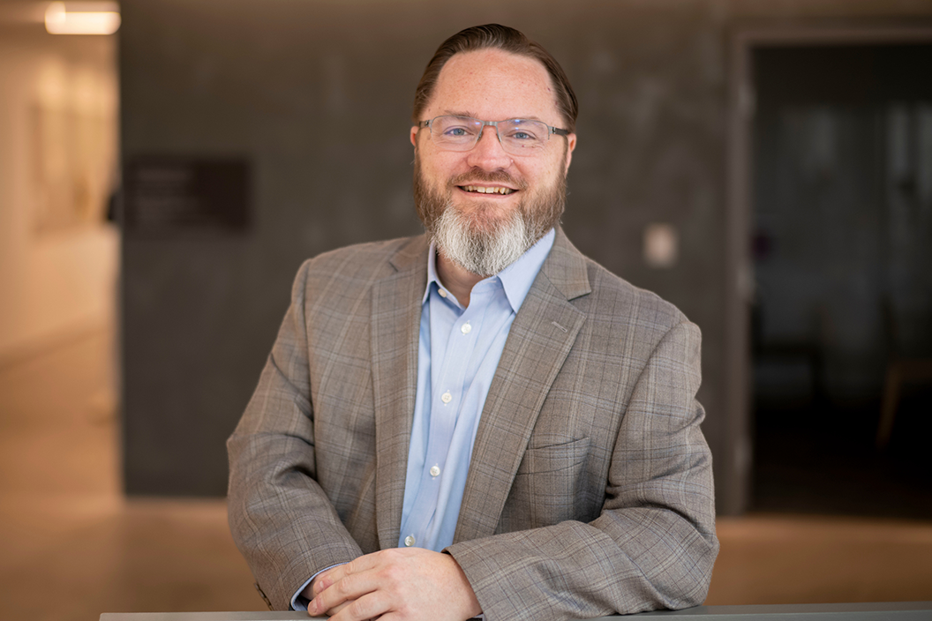
Regional Science DMZ - IT Perspective
Jason Simms, PhD, Swarthmore College

Slide 12
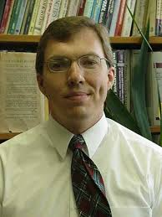
Regional Science DMZ – Research/Administrative Impacts
Frederick Adkins, PhD, Indiana University of Pennsylvania

Slide 13
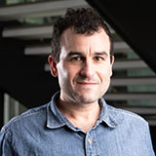
Regional Science DMZ – Research/Administrative Impacts
Ezra Lencer, PhD, Lafayette College

Slide 14
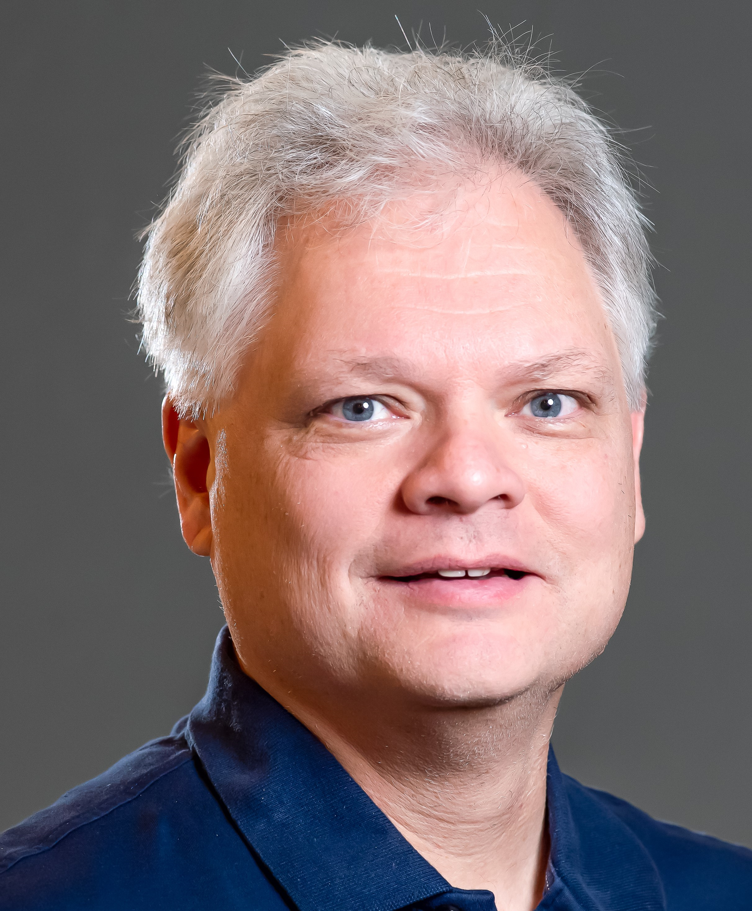
Regional Science DMZ – Research/Administrative Impacts
Bill Balint, Indiana University of Pennsylvania

Slide 15
Q & A

Slide 16
Thank you

